Slide 1




Kilian Schulte
Tim Benthien
Anja Oberender
Dominik Wernberger

Slide 2
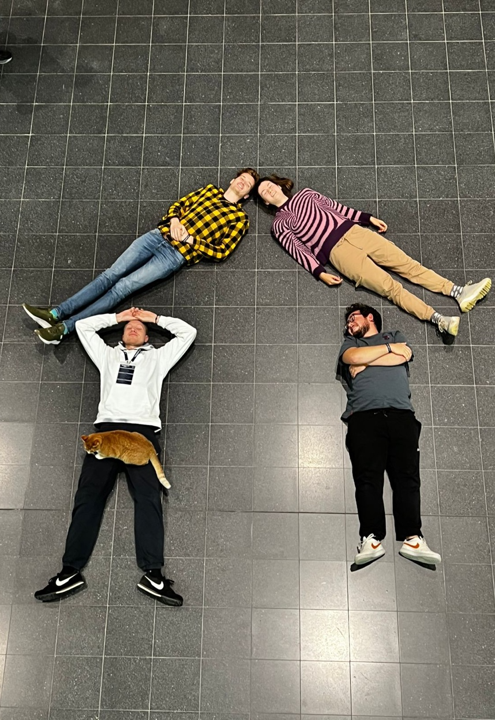

OUR TEAM
KILIAN SCHULTE
ANJA OBERENDER
Front End
Concept and Design
TIM BENTHIEN
Back End
DOMINIK WERNBERGER
Graphics
SAMMY
Emotional
Support Cat

Slide 3
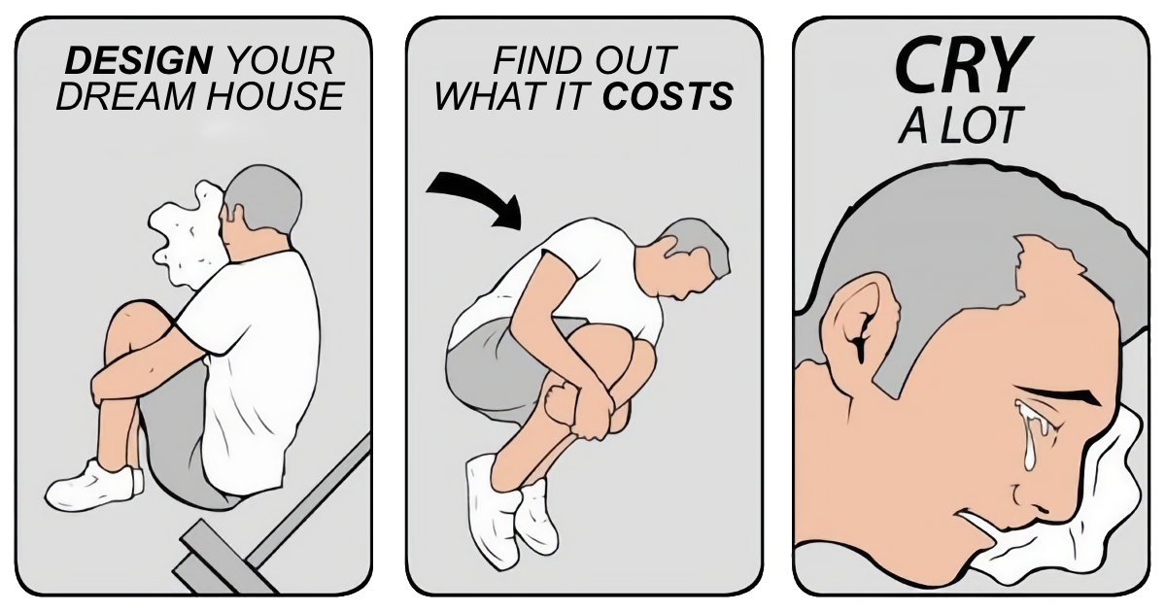

Slide 4
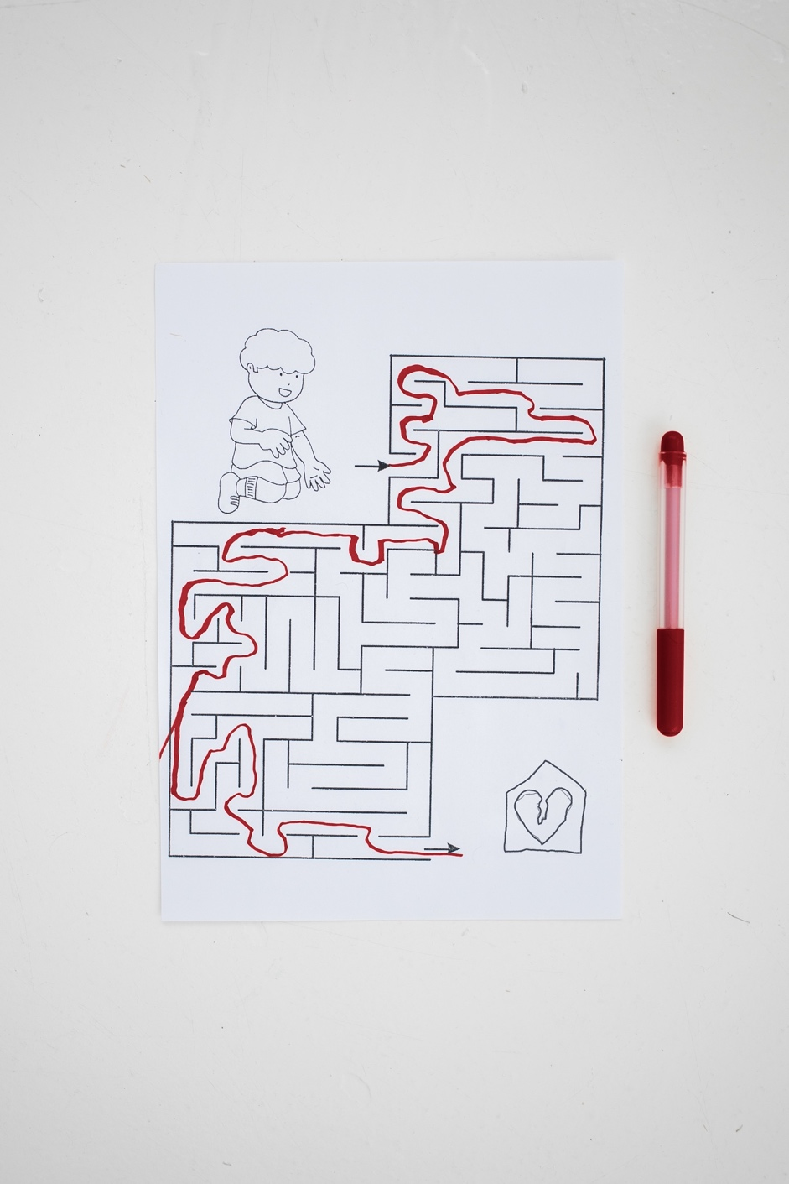

PROBLEM
HOUSECRUSH
You don‘t know how you‘ll live in the future
Plan your dream house and
know your finances

Slide 5



LIVE DEMO
www.housecrush.schultek.de
Backup: https://youtu.be/SXE0UHpfxZc

Slide 6





ANY QUESTIONS?
THANKS FOR LISTENING

Slide 7
PRESENTATION TEMPLATE CREDITS
Presentation template by Slidesgo
Icons by Flaticon
Infographics by Freepik
Images created by Freepik - Freepik
Author introduction slide photo created by Freepik
Text & Image slide photo created by Freepik.com

